Slide 1
CS422 Database systems
Today: Transactions & concurrency control
Data-Intensive Applications and Systems (DIAS) Laboratory École Polytechnique Fédérale de Lausanne
Slides adapted from material of Andy Pavlo (CMU) & Christoph Koch (EPFL)

Slide 2
Overview
Transactions and ACID
Schedules
Locking protocols
2PL, strict 2PL

Slide 3
Definition of transactions
A transaction (txn, or Xact) is a sequence of actions that are executed on a shared database to perform some higher-level function.
Transactions are the basic unit of change in the DBMS. No partial txns are allowed.

Slide 4
A quick reminder of ACID
Atomicity: Either all actions in the txn happen, or none happen.
Consistency: If each txn is consistent, and the DB starts consistent, it ends up consistent.
Isolation: Execution of one txn is isolated from that of other txns.
Durability: If a txn commits, its effects persist.

Slide 5
Atomicity and Durability
A transaction might commit after completing all its actions, or it could abort (or be aborted by the DBMS) after executing some actions.
All transactions are atomic.
A user can think of a txn as always executing all its actions in one step, or not executing any actions at all.
DBMS logs all actions so that it can undo the actions of aborted transactions.
Durability also relies on logs

Slide 6
Consistency and Isolation
Each transaction must leave the database in a consistent state.
DBMS will enforce some integrity constraints.
Clearly, no semantic consistency.
Users submit transactions, and expect isolation -- each transaction executed by itself.
Concurrency very important for performance: interleaving actions from different transactions.
Net effect identical to executing all transactions one after the other in some serial order.

Slide 7
A note on concurrency
Several transactions arrive at (almost) the same time
Need to execute in parallel to fully utilize hardware
T1:
R(A)
R(B)
compute-something
W(C)
COMMIT
T2:
R(E)
R(A)
R(D)
compute-something
…
T3:
R(D)
compute-something
R(E)
…
User writes SQL queries.
Translated to actions!

Slide 8
Schedules
The DBMS gets as input a set of transactions and executes a schedule.
Schedule: a list of actions (reading, writing, aborting, or committing) from a set of txns
All actions appear in the schedule
The order in which two actions of a transaction T appear in a schedule must be the same as the order in which they appear in T.

Slide 9
Example
T1: transfer $100 from B’s account to A’s account. T2: credit both accounts with a 6% interest payment.
There is no guarantee that T1 will execute before T2 or vice-versa, if both are submitted together.
Actions of two transactions can interleave!
However, the net effect must be equivalent to these two transactions running serially in some order.
T1: BEGIN A=A+100, B=B-100 END
T2: BEGIN A=1.06*A, B=1.06*B END

Slide 10
Example (Contd.)
Consider a possible interleaving schedule:
This is OK. But what about:
The system’s view of the second schedule:
T1: A=A+100, B=B-100
T2: A=1.06*A, B=1.06*B
T1: A=A+100, B=B-100
T2: A=1.06*A, B=1.06*B
T1: R(A), W(A), R(B), W(B)
T2: R(A), W(A), R(B), W(B)

Slide 11
Scheduling Transactions
There can be more than one serializable schedules and more than one final states
Serial schedule: Schedule that does not interleave the actions of different transactions.
Equivalent schedules: For any database state, the effect (on the set of objects in the database) of executing the first schedule is identical to the effect of executing the second schedule.
Serializable schedule: A schedule that is equivalent to some serial execution of the transactions.
If each transaction preserves consistency, every serializable schedule preserves consistency.

Slide 12
Anomalies with Interleaved Execution
Anomalies created when we have at least one write!
Reading Uncommitted Data (WR Conflicts, “dirty reads”):
Unrepeatable Reads (RW Conflicts):
Overwriting Uncommitted Data (WW Conflicts):
T1: R(A), W(A), R(B), W(B), Abort
T2: R(A), W(A), C
T1: R(A), R(A), W(A), C
T2: R(A), W(A), C
T1: W(A), W(B), C
T2: W(A), W(B), C

Slide 13
Aborting a Transaction
Think of concrete scenarios where cascading aborts are very costly!
If T_{i} is aborted, all its actions have to be undone.
Cascading aborts: If T_{j} reads an object last written by T_{i}, T_{j} must be aborted as well!
Alternative to avoid cascading aborts: If T_{i} writes an object, T_{j} can read this only after T_{i} commits.
DBMS maintains a write log, in order to be able to undo the actions of aborted txns.
Also used to recover from system crashes: all active txns at the time of the crash are aborted when the system comes back up.

Slide 14
Conflict Serializable Schedules
Two schedules are conflict equivalent if:
They involve the same actions of the same transactions
Every pair of conflicting actions is ordered the same way
i.e., we can turn the one into the other by swapping non-conflicting adjacent actions
Schedule S is conflict serializable if S is conflict equivalent to some serial schedule.

Slide 15
Example
A schedule that is not conflict serializable:
Dependency graph: One node per txn; edge from T_{i} to T_{j} if T_{j} reads/writes an object last written by T_{i}.
The cycle in the graph reveals the problem. The output of T1 depends on T2, and vice-versa.
T1: R(A), W(A), R(B), W(B)
T2: R(A), W(A), R(B), W(B)
A
Dependency graph
a.k.a. precedence graph
T1
T2
B

Slide 16
Dependency Graph
Dependency graph: One node per txn; edge from T_{i} to T_{j} if T_{j} reads/writes an object last written by T_{i}.
Theorem: A schedule is conflict serializable if and only if its dependency graph is acyclic

Slide 17
Concurrency protocols
Two-phase locking (2PL)
Pessimistic approach
Assume txns will conflict!
Acquire locks on all items before accessing them!

Slide 18
Lock-Based Concurrency Control
Transactions acquire locks before reading and writing
Locking protocol guarantees that schedule will be conflict serializable (correct) if it completes
Deadlocks are possible
Locking granularity can be anything
Tables, indexes, pages, records

Slide 19
Lock-Based Concurrency Control
Two-Phase Locking (2PL) Protocol
Rule 1: Each txn obtains
S (shared) lock before reading
X (exclusive) lock before writing
Sometimes also called read/write locks
Rule 2: A txn cannot request additional locks once it releases any locks.
2PL allows only schedules whose precedence graph is acyclic => serializable.
Example schedule with locks:
T1: S(A) R(A) S(B) R(B)
T2: X(C) R(C) W(C) S(D) R(D)

Slide 20
Lock-Based Concurrency Control
Two-Phase Locking (2PL) Protocol
Rule 1: Each txn obtains
S (shared) lock before reading
X (exclusive) lock before writing
Sometimes also called read/write locks
Rule 2: A txn cannot request additional locks once it releases any locks.
2PL allows only schedules whose precedence graph is acyclic => serializable.
Strict Two-phase Locking (Strict 2PL) Protocol
Rule 3: All locks released when the txn completes.
Strict 2PL additionally simplifies transaction aborts
(Non-strict) 2PL involves more complex abort processing.

Slide 21
Deadlocks
Deadlock: Cycle of transactions waiting for locks to be released by each other.
Two ways of dealing with deadlocks
Deadlock detection: detect and resolve deadlocks when they are created.
Deadlock prevention: never let deadlocks happen.

Slide 22
Deadlock Detection
If a lock request cannot be satisfied, the transaction is suspended and must wait until the resource becomes available.
Create a waits-for graph:
Nodes are transactions
Edge from T_{i} to T_{j} if T_{i} is waiting for T_{j} to release a lock
Periodically check for cycles in the waits-for graph

Slide 23
Deadlock Detection (Continued)
Example:
T1: S(A) R(A) S(B)
T2: X(B) W(B) X(C)
T3: S(C) R(C) X(A)
T4: X(B)
T1
T2
T1
T2
T4
T3
T4
T3

Slide 24
Deadlock Prevention
Assign priorities based on timestamps.
Earlier timestamp → higher priority
Assume T_{i} wants a lock that T_{j} holds. Two policies:
Wait-Die: It T_{i} has higher priority, T_{i} waits for T_{j}. Otherwise T_{i} aborts
Wound-wait: If T_{i} has higher priority, T_{j} aborts. Otherwise T_{i} waits
If a transaction re-starts, make sure it has its original timestamp

Slide 25
Fixed vs dynamic databases
Fixed tuples
Set of tuples is fixed
Can update, but no inserts/deletes
Can lock all related tuples
UPDATE employees SET salary=salary*1.2 WHERE age>60
Dynamic databases
Can insert/delete tuples
Cannot lock all related tuples
INSERT INTO employees(name,age,salary) VALUES(“Superman”, 62, 10000)

Slide 26
Dynamic Databases
If insertions/deletions are allowed, then even Strict 2PL cannot assure serializability
T1: Print the oldest sailors with rating=1 and rating=2
T2: Insert a sailor with (rating=1,age=96), and delete the oldest sailor with rating=2
The results may not correspond to a serial execution → not conflict-serializable!

Slide 27
Dynamic Databases
If insertions/deletions are allowed (not only updates), then even Strict 2PL cannot assure serializability
T1 locks all pages containing sailor records with rating = 1, and finds oldest sailor (age = 71).
Next, T2 inserts a new sailor; rating = 1, age = 96.
T2 also deletes oldest sailor with rating = 2 (age = 80), and commits.
T1 now locks all pages containing sailor records with rating = 2, and finds oldest (age = 63).
Not conflict serializable!!!
T1: S(A*) R(A*) S(B*) R(B*) W(C)
T2: X(A’) I(A’) X(B) D(B)

Slide 28
How did serializability break aka “The phantom menace”
T1 implicitly assumes that it has locked the set of all sailor records with rating = 1.
Assumption only holds if no sailor records are added while T1 is executing!
Conflict serializability guarantees serializability only if the set of objects is fixed!
Need some mechanism to enforce this assumption.
(Index locking and predicate locking).

Slide 29
Predicate Locking
Implicitly lock all records (also new) that satisfy a logical predicate
I.e., rating=1 or rating=2.
How would you implement predicate locking?
Very expensive

Slide 30
Index Locking
T1 locks the index pages containing the data entries with rating = 1 and rating = 2.
Index needs to be updated after the insert → will fail if locked
If there are no records with rating = 1, T1 must lock the index page where such a data entry would be, if it existed!
Special case of predicate locking – more efficient implementation.

Slide 31
Are 2PL protocols always good?
Locking: Conservative approach in which conflicts are prevented.
Disadvantages
Lock management overhead.
Deadlock detection/resolution.
Lock contention for heavily used objects.
If conflicts are rare, gain concurrency by not locking, and instead checking for conflicts before txns commit
more on the other side part of the lesson

Slide 32
Describing transactions
Different transaction models
Flat txns
Flat txns with savepoints
Chained txns
Nested txns
Saga txns
Compensating txns
Commercial DBMS do not support all models!

Slide 33
Flat Transactions
The standard txn model
Starts with BEGIN
One or more actions
Completes with COMMIT or ROLLBACK
BEGIN
BEGIN
READ
READ
WRITE
WRITE
COMMIT
ROLLBACK

Slide 34
Limitations of flat txns
It’s all or nothing – coarse-grained granularity!
Commit all, or rollback all
No partial rollbacks!
If DBMS fails, all work is lost
Think of updating millions of tuples!
Still, will not lose old data – the D in ACID!
Each txn takes place at a single point in time
Actions need to be predefined when transaction starts!
Cannot interrupt, ask the user, and then continue the tnx

Slide 35
Limitations of flat txns
Applications limited by flat txns
Multi-stage planning
Not all applications know a priori all actions
E.g., book a trip (flight, train, hotel, …)
Bulk updates
How to update 1 billion records
In the presence of failures
And without locking the entire database
Sometimes, bulk updates have a huge impact!
Please note that online banking will be unavailable
next Sunday, between 03:00 and 05:00 for maintenance. We apologize for any inconvenience.

Slide 36
Transaction savepoints
Savepoint: Save the current state of processing for the txn and provide a handle for the application to refer to that savepoint
ROLLBACK
Revert all changes back to the state of the savepoint
RELEASE
Destroy a previously-defined savepoint

Slide 37
Transaction savepoints
Txn #1
Savepoint#1
BEGIN
WRITE(A)
Savepoint#2
A
SAVEPOINT 1
X
WRITE(B)
B
Savepoint#3
ROLLBACK TO 1
WRITE(C)
C
COMMIT
What will commit write?

Slide 38
Transaction savepoints
Txn #1
Savepoint#1
BEGIN
X
X
X
X
WRITE(A)
Savepoint#2
A
X
X
X
X
SAVEPOINT 1
X
X
X
X
X
X
WRITE(B)
B
Savepoint#3
X
X
X
X
X
X
SAVEPOINT 2
X
X
X
X
X
X
WRITE(C)
C
X
X
SAVEPOINT 3
X
X
X
X
#4
RELEASE 2
WRITE(D)
D
ROLLBACK TO 3
???
…

Slide 39
Transaction chains
Multiple txns executed one after another.
Combined COMMIT/BEGIN operation is atomic.
No other txn can change the state of the database as seen by the second txn from the time that the first txn commits and the second txn begins.
Differences with savepoints
Commit allows the DBMS to free locks
Cannot rollback previous txns in chain.

Slide 40
Transaction chains
Txn #1
BEGIN
WRITE(A)
Txn #2
COMMIT
BEGIN
WRITE(B)
Txn #3
COMMIT
BEGIN
COMMIT/BEGIN is atomic
Rollback: On a single transaction
WRITE(C)
ROLLBACK

Slide 41
Nested transactions
Savepoints organize a transaction as a sequence of actions that can be rolled back individually
Nested txns form a hierarchy of work
The outcome of a child txn depends on the outcome of its parent txn

Slide 42
Nested transactions
Txn #1
BEGIN
WRITE(A)
sub-txn #1.1
BEGIN
X
BEGIN
WRITE(B)
WRITE(B)
sub-txn #1.1.1
BEGIN
BEGIN
X
BEGIN
WRITE(C)
WRITE(C)
WRITE(C)
X
COMMIT
COMMIT
COMMIT
WRITE(D)
WRITE(D)
ROLLBACK
ROLLBACK
COMMIT
What is committed here?

Slide 43
Compensating transactions
Why do we need compensating transactions? Why not just restore the old value?
A special type of txn designed to semantically reverse the effects of another already committed txn
Reversal has to be logical instead of physical.
Example: decrement a counter by one instead of reverting to the original value!

Slide 44
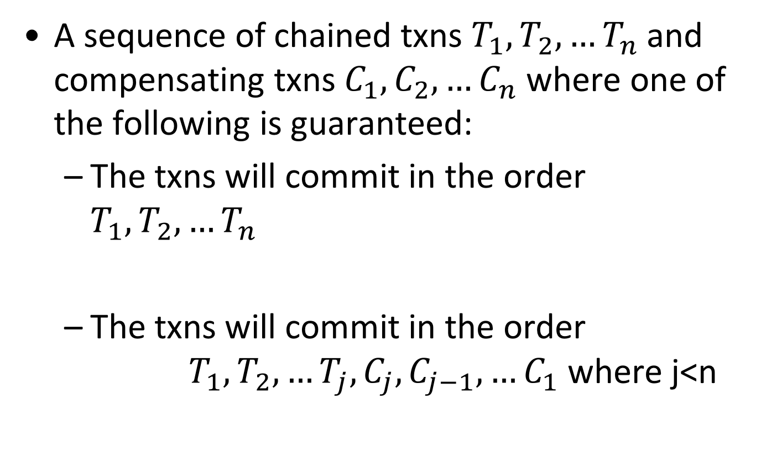
SAGA transactions
A sequence of chained txns $T_{1}, T_{2},…T_{n}$ and compensating txns $C_{1}, C_{2},…C_{n}$ where one of the following is guaranteed:
The txns will commit in the order $T_{1}, T_{2},…T_{n}$
The txns will commit in the order $T_{1}, T_{2},…T_{j}, C_{j}, C_{j−1}, …C_{1}$ where j<n

Slide 45
SAGA transactions
Txn #1
Txn #2
Txn #3
BEGIN
BEGIN
BEGIN
WRITE(A+1)
WRITE(B+1)
WRITE(C+1)
COMMIT
COMMIT
COMMIT
Comp. Txn #1
Comp. Txn #2
Comp. Txn #3
BEGIN
BEGIN
BEGIN
WRITE(A+1)
WRITE(B+1)
WRITE(C+1)
COMMIT
COMMIT
COMMIT

Slide 46


Slide 47
Concurrency protocols
Two-phase locking (2PL)
Pessimistic approach
Assume txns will conflict!
Acquire locks on all items before accessing them!
Timestamp ordering (T/O)
Optimistic approach
Assume that conflicts are rare!
Do not acquire locks, check for conflicts at commit!

Slide 48
Optimistic Concurrency Control
The Kung-Robinson Model
Key idea: Timestamp ordering is imposed on transactions, and validation phase checks that all conflicting actions occurred in the same order.
If this is not the case, abort the transaction that started later!

Slide 49
Kung-Robinson Model
Txns have three phases:
READ: txns read from the database, but make changes to private copies of objects.
VALIDATE: Check for conflicts.
WRITE: Make local copies of changes public.
old
modified
objects
ROOT
new

Slide 50
Validation
Test conditions that are sufficient to ensure that no conflict occurred.
Each txn assigned a numeric id.
Just use a timestamp.
Txn ids assigned at end of READ phase, just before validation begins.
ReadSet(T_{i}): Set of objects read by txn T_{i}.
WriteSet(T_{i}): Set of objects modified by T_{i}.

Slide 51
Test 1
For all i and j such that T_{i} < T_{j}, check that T_{i} completes before T_{j} begins.
T_{i}
T_{j}
R
V
W
R
V
W

Slide 52

Test 2
For all i and j such that T_{i} < T_{j}, check that:
T_{i} completes before T_{j} begins its Write phase
WriteSet(T_{i}) $⋂$ ReadSet(T_{j}) is empty.
T_{i}
R
V
W
T_{j}
R
V
W
“Does T_{j} read dirty data?”

Slide 53

Test 3
For all i and j such that T_{i} < T_{j}, check that:
T_{i} completes Read phase before T_{j} does +
WriteSet(T_{i}) $⋂$ReadSet(T_{j}) is empty +
WriteSet(T_{i}) $⋂$WriteSet(T_{j}) is empty.
T_{i}
R
V
W
T_{j}
R
V
W
“Does T_{j} read dirty data?”
“Does T_{i} overwrite T_{j}’s writes?”

Slide 54
Example: Optimistic CC
T1: R(A), W(A), R(B), W(B) C
T2: R(A), W(A), R(B), W(B) C
T1: R(A), W(A), R(B), W(B)
READ VALIDATE WRITE
T2: R(A), W(A), R(B), W(B)
READ VALIDATE WRITE

Slide 55
Example: Optimistic CC
T1: R(A), W(A), R(B), W(B)
READ VALIDATE WRITE
T2: R(A), W(A), R(B), W(B)
READ VALIDATE WRITE
Validation of T2:
Test 1: ???
For all i and j such that T_{i} < T_{j}, check that T_{i} completes before T_{j} begins.

Slide 56

Example: Optimistic CC
T1: R(A), W(A), R(B), W(B)
READ VALIDATE WRITE
T2: R(A), W(A), R(B), W(B)
READ VALIDATE WRITE
Validation of T2:
Test 1: fails Test 2: ???
For all i and j such that T_{i} < T_{j}, check that:
T_{i} completes before T_{j} begins its Write phase
WriteSet(T_{i}) $⋂$ ReadSet(T_{j}) is empty.

Slide 57

Example: Optimistic CC
T1: R(A), W(A), R(B), W(B)
READ VALIDATE WRITE
T2: R(A), W(A), R(B), W(B)
READ VALIDATE WRITE
Validation of T2:
Test 1: fails Test 2: fails Test 3: ???
For all i and j such that T_{i} < T_{j}, check that:
T_{i} completes Read phase before T_{j} does +
WriteSet(T_{i}) $⋂$ReadSet(T_{j}) is empty +
WriteSet(T_{i}) $⋂$WriteSet(T_{j}) is empty.

Slide 58
Example: Optimistic CC
T1: R(A), W(A), R(B), W(B)
READ VALIDATE WRITE
T2: R(A), W(A), R(B), W(B)
READ VALIDATE WRITE
Validation of T2:
Test 1: fails Test 2: fails Test 3: fails
T2 gets restarted once T1 is completely finished

Slide 59
Comments on Validation
Assignment of txn id, validation, and the Write phase are inside a critical section!
Nothing else goes on concurrently.
If validation/write phase is long, major drawback!
Optimization for Read-only txns:
Shorter critical section (because there is no Write phase).

Slide 60
Overheads in Optimistic CC
Record read/write activity in ReadSet and WriteSet per txn.
Must create and destroy these sets as needed.
Check for conflicts during validation, and make validated writes “global”.
Critical section can reduce concurrency.
Optimistic CC restarts txns that fail validation.
Work done so far is wasted.
Requires clean-up.

Slide 61
Timestamp-based CC
Optimistic CC: Timestamp ordering is imposed on transactions, and validation checks that all conflicting actions occurred in the same order.
Timestamp-based CC
Continuous validation – not a distinct phase
Keep read and write timestamps per object, and starting timestamp of each txn
Compare txn timestamp with read/write timestamps of the objects in order to decide between:
Continue, Abort, Commit, Skip write
Continuous, per-object validation
Notes:
1.18 before this slide

Slide 62
Timestamp-based CC
Idea:
Txn timestamp TS ← begin time
Object: read-timestamp (RTS) and a write-timestamp (WTS)
If action a_{i} of txn T_{i} conflicts with action a_{j} of txn T_{j}, and TS(T_{i}) < TS(T_{j}), then a_{i} must occur before a_{j}. Otherwise, restart violating txn.
Use RTS, WTS to detect conflicts.
Object | Read-timestamp | Write-Timestamp
A | 10 | 4
B | 15 | 13
… | … | …

Slide 63
When txn T wants to READ Object O
TS(T) < WTS(O): violates timestamp order of T w.r.t. writer of O.
Abort T and restart it with a new, larger TS.
TS(T) >= WTS(O):
Allow T to read O.
Reset RTS(O) to max(RTS(O), TS(T))
Change to RTS(O) on reads must be written in some persistent fashion → overhead.

Slide 64
When txn T wants to write Object O
TS(T) < RTS(O): violates timestamp order of T w.r.t. writer of O → abort and restart T.
TS(T) < WTS(O) → violates timestamp order of T w.r.t. writer of O. → ???
Thomas Write Rule: Outdated write → Safely ignore; need not restart T! Allows some serializable schedules (correct) that are not conflict serializable.
Else, allow T to write O (and update WTS(O)).
Notes:
Thomas write rule: T’s write is effectively followed by another write, with no intervening reads.

Slide 65
Timestamp-based CC and Recoverability
Unrecoverable schedules are possible
Solution
Make changes of T1 in a memory buffer and block T2 from committing
Write changes to disk ONLY at commit
T1 T2
W(A)
R(A)
W(B)
Commit
Abort

Slide 66
Multiversion Concurrency Control
Goal: A transaction never waits on read!
Idea
Maintain several versions of each database object (multi-version), each with a read and a write timestamp.
Transaction T_{i} reads the most recent version whose write timestamp precedes TS(T_{i}), i.e., WTS(O)<TS(T_{i}).
Multiversioning is a storage mgmt concept!
Combine with CC => MVTO, MVOCC, MV2PL

Slide 67
Multiversion Concurrency Control
MVCC lets writers make a “new” copy while readers use an appropriate “old” copy:
Current
versions of
DB objects.
Older versions that
may be useful for
some active readers.
O
O’
O’’
MAIN
SEGMENT
VERSION POOL

Slide 68
MV + Timestamp Ordering (MVTO)
For each version
WTS: the timestamp of the txn that created it
RTS: the timestamp of the txn that last read it
Versions are (usually) chained backward; we can discard versions that are “too old to be of interest” (i.e., garbage collection).
Each txn is classified as Reader or Writer.
Writer may write some object; Reader never will.
Txn declares whether it is a Reader when it begins.
Readers are always allowed to proceed.

Slide 69
Reader txn
For each object to be read:
Finds newest version with WTS < TS(T): Starts with current version in the main segment and chains backward through earlier versions.
Updates RTS to MAX(RTS, TS(T)).
Reader txns are never restarted.
old new
WTS timeline
T
Readers always proceed

Slide 70
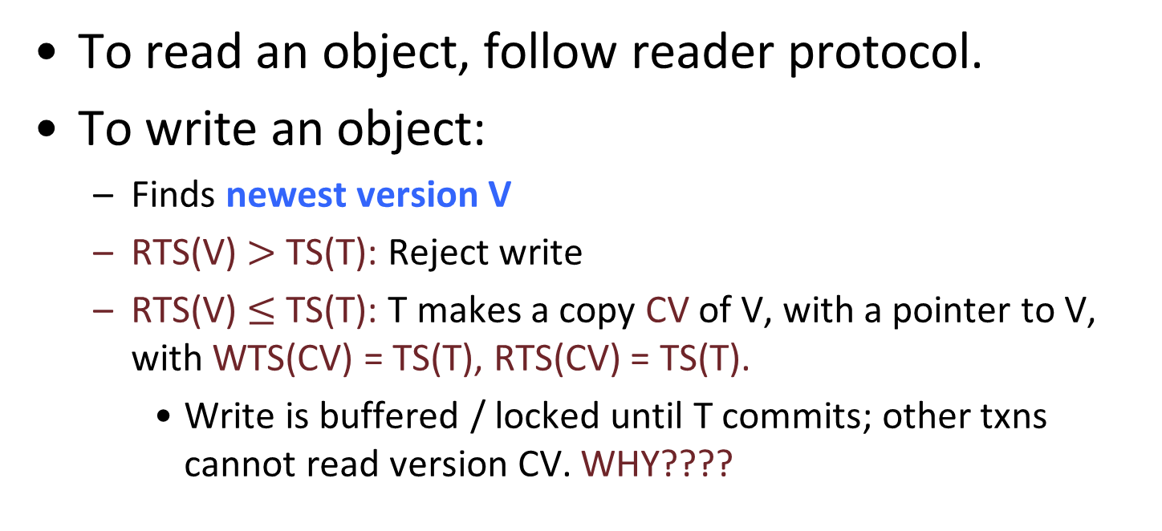
Writer txn
To read an object, follow reader protocol.
To write an object:
Finds newest version V
RTS(V) $>$ TS(T): Reject write
RTS(V) $≤$ TS(T): T makes a copy CV of V, with a pointer to V, with WTS(CV) = TS(T), RTS(CV) = TS(T).
Write is buffered / locked until T commits; other txns cannot read version CV. WHY????
Writers create new copy (…if no younger transaction has read the data) (…and if no active xaction holds V’s lock )

Slide 71
Bottlenecks
Lock thrashing
2PL, Strict 2PL
Timestamp allocation
All T/O algorithms + deadlock prevention
Memory allocation
MVCC, OCC

Slide 72
Improving performance of txn
Goal is to
reduce conflicts
reduce time spent on each transaction
Three key approaches
Stored procedures --> faster
Prepared statements --> precompiled
Query batches --> batch locking

Slide 73
Snapshot isolation
Snapshot isolation (SI) is the most popular isolation guarantee in real DBMS.
all txn reads will see a consistent snapshot of the database
the txn successfully commits only if no updates it has made conflict with any concurrent updates made since that snapshot.
SI does not guarantee serializability!
SerializableSI: Stronger, more conservative protocol
Implemented in Oracle, MS SQL Server, Postgres.

Slide 74
Snapshot isolation
Conceptually, txn works on a copy of the db made at txn start time.
Very expensive → not implemented that way but still expensive.
Guarantees that reads in the txn see a consistent version of the db.
At commit time, verify that the values changed by the transaction have not been changed by other transactions since the snapshot was taken.
Write skew anomaly
Not serializable, but permitted by snapshot isolation!
T1: R(X)R(Y) W(X) C
T2: R(X)R(Y) W(Y) C

Slide 75
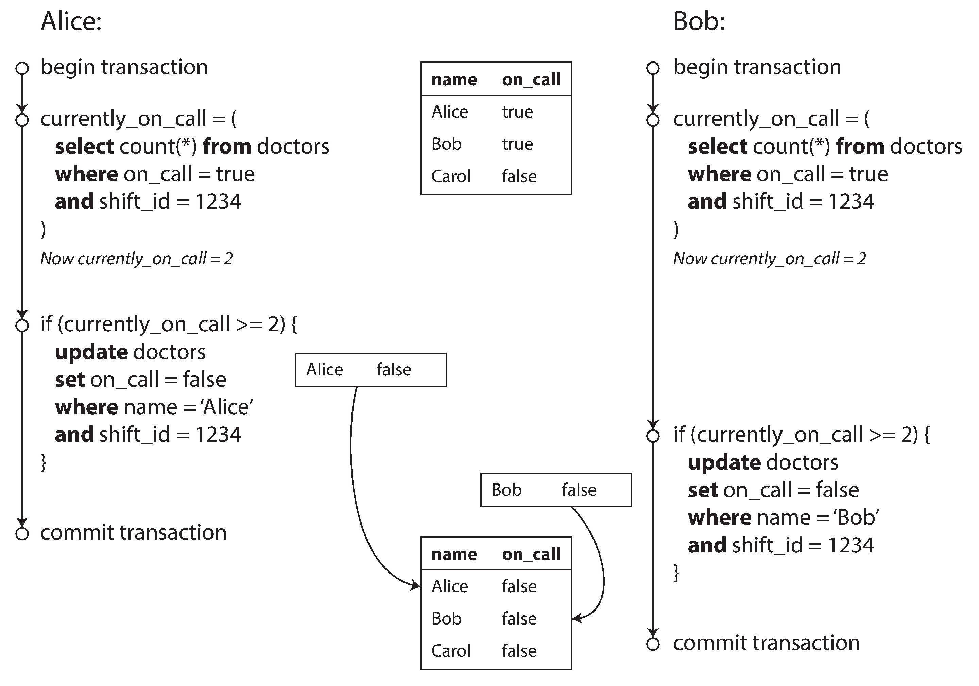
Write skew – (more concrete) example
[Source: Martin Kleppmann]

Slide 76
Discussion
SI is related to optimistic CC, in that
Conceptually, snapshots are created at txn start.
There is an analysis phase at the end to decide whether a transaction may commit (do writesets overlap?).
Multiversion CC is a way to implement (a stronger) snapshot isolation.

Slide 77
Transaction Support in SQL-92
Transaction characteristics:
Access mode: Read-only, Read-write
Isolation level: How isolated is each txn compared to other concurrent txns
Let the developer/user choose isolation level based on the importance of the task!
Isolation Level
Dirty Read
Unrepeatable Read
Phantom Problem
Read Uncommitted
Maybe
Maybe
Maybe
Read Committed
No
Maybe
Maybe
Repeatable Reads
No
No
Maybe
Serializable
No
No
No
Notes:
Isolation levels and problems: see details in the textbook!

Slide 78
Backup Slides

Slide 79
View Serializability
Schedules S1 and S2 are view equivalent if:
T_{i} reads initial value of A in S1, then T_{i} also reads initial value of A in S2
T_{i} reads value of A written by T_{j} in S1, then T_{i} also reads value of A written by T_{j} in S2
T_{i} writes final value of A in S1, then T_{i} also writes final value of A in S2
Blind writes
T1: R(A) W(A)
T2: W(A)
T3: W(A)
T1: R(A) W(A)
T2: W(A)
T3: W(A)
Notes:
We have been talking about conflict serializability. We also have view serializability.
View serializability is weaker than conflict serializability. All conflict serializable schedules ARE view serializable, but not vice versa. We only need view serializability!
Blind writes: Write a value without reading it first.
The key is that blind writes offer more flexibility

Slide 80
View Serializability
Neat idea, but too expensive to check for view serializability → useless in practice
Blind writes: Write a value without reading it first, e.g., update employees set salary=1000 where name=“Amy”
View serializable → view equivalent to some serial schedule
T1: R(A) W(A)
T2: W(A)
T3: W(A)
T1: R(A) W(A)
T2: W(A)
T3: W(A)

Slide 81
Example
T1: R(A) W(B) C
T2: R(B) W(A) C
RTS WTS V0
A: 0 0 15
B: 0 0 6
Notes:
Example shown at blackboard
Here, t1 will fail but T2 will commit.

Slide 82
Readings
COW Book (3rd edition), chapters 16, 17
or
COW Book (2nd edition), chapters 18, 19
(This material is partially covered at CS-322)

